Slide 1
Facts About Apemen
Mike Riddle
Answers in Genesis

Slide 2
Topics
A history of apemen – the track record
Two case studies
Neandertals
Australopithecines and Lucy
How evolution hinders critical thinking
How things change

Slide 3
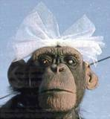
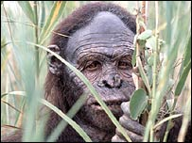
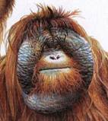
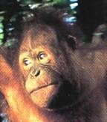
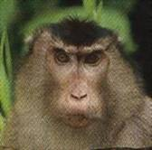
History of Man
The Bible teaches that God created man
Evolution begins with the assumption that man has evolved from ape-like creatures
So God created man in his own image, in the image of God created he him; male and female
Genesis 1:27
Pick your relative

Slide 4
School Textbooks
Holt, Rinehart, & Winston, Biology – Visualizing Life, 1998, p. 213.
“Look closely at your hand. You have five flexible fingers. Animals with five flexible fingers are called primates. Monkeys, apes, and humans are examples of primates….Primates most likely evolved from small, insect-eating rodentlike mammals that lived about 60 million years ago.”

Slide 5
School Textbooks
Miller and Levine, Biology, 2000, p. 757.
“But all researchers agree on certain basic facts. We know, for example, that humans evolved from ancestors we share with other living primates such as chimpanzees and apes.”

Slide 6
Piltdown Man
Segment of lower ape-like jaw
Segment of human skull
Notes:
Parts found between 1908 and 1912 in Piltdown, England
Portion of human skull
Portion of lower ape-like jaw
The claim: 500,000 year old intermediate link

Slide 7
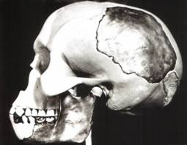
Piltdown Man
Parts found between 1908 and 1912 in Piltdown, England
Portion of human skull
Portion of lower ape-like jaw
The claim: 500,000 year old intermediate link

Slide 8
Piltdown Man
New York Times ran an article:
“Darwin Theory Proved True.”
Featured in textbooks and encyclopedias
In 1953 scientists studied the bones
The Truth
A fraud (600 year old bones)

Slide 9
Nebraska Man
1922 fossil evidence was discovered
Used to support evolution in the 1925 Scopes trial
The claim: 1 million year old intermediate link
The Truth
An extinct pig's tooth

Slide 10
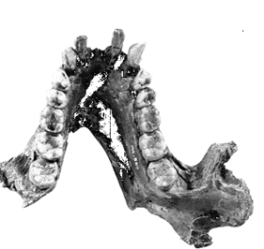
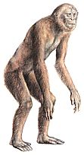
Ramapithecus
1930s
What they found
What they drew
Notes:
Pithecos = Greek for ape
Discovered in 1930s: jaw fragments and teeth

Slide 11
Ramapithecus
Time Magazine (Nov. 7, 1977)
“Ramapithicus is ideally structured to be an ancestor of hominids. If he isn't, we don't have anything else that is.”

Slide 12
Ramapithecus
The claim: 14 million year old intermediate between ape-like creatures and humans
The truth
In 1970 a baboon living in Ethiopia was discovered.
Same dental structure
Similar morphological features found on Ramapithecus
Ramapithecus dropped from human line

Slide 13
Summary of “Facts”
Piltdown Man ……… Hoax
Nebraska Man …….. Pig
Ramapithecus …….. Ape
What about the dates?
In each case the date (age) was completely WRONG!

Slide 14
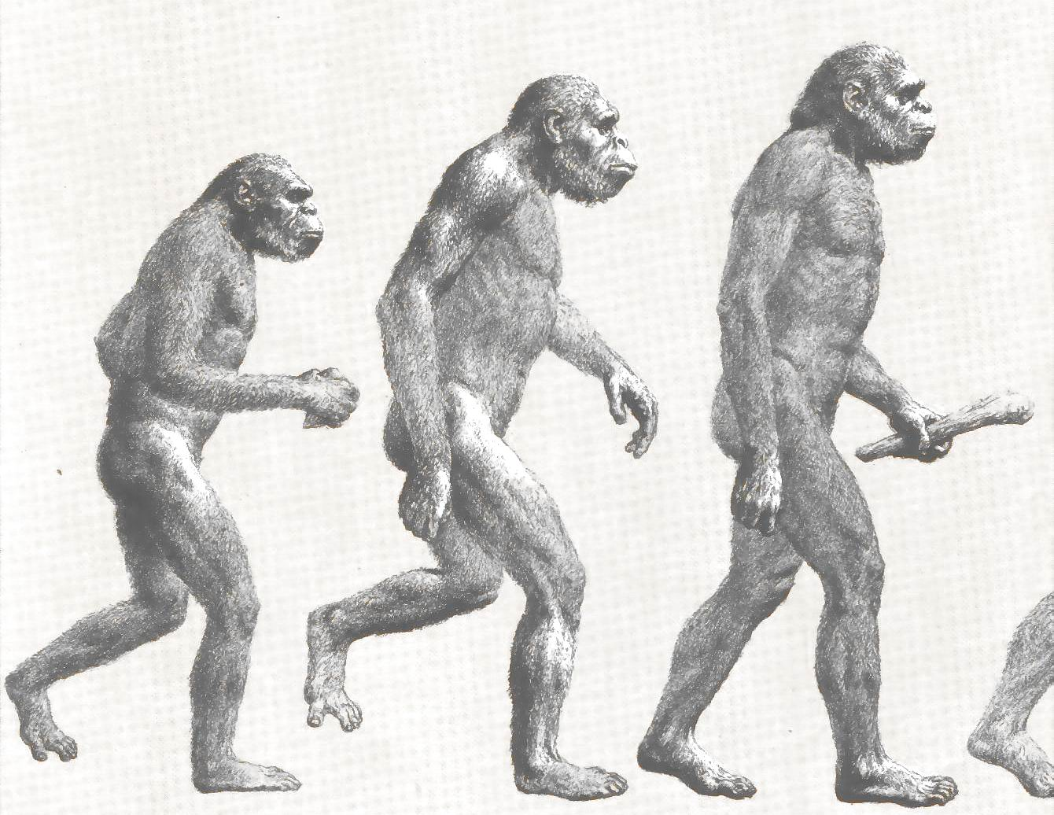
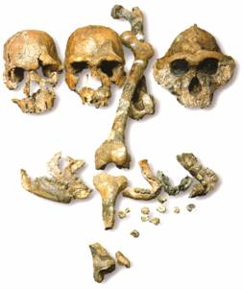
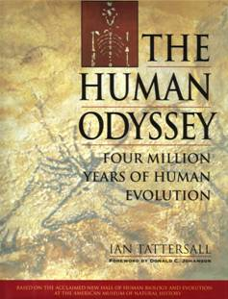
Two Case Studies
Neandertals
Lucy and the Australopithicines

Slide 15
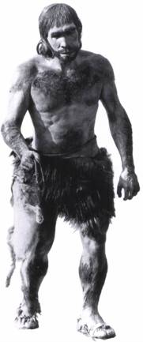
Case Study 1
Neandertals
Characteristics
Anatomy
Genetics (DNA)

Slide 16
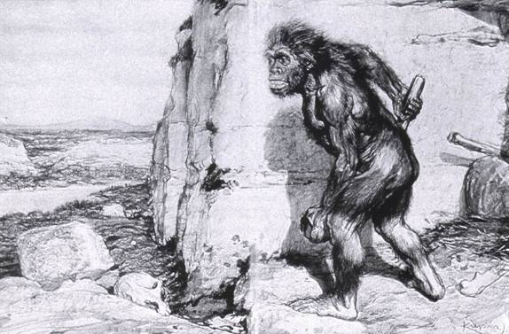
Neandertals
Original Drawing of Neandertal

Slide 17
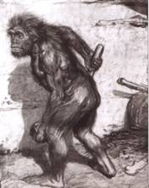
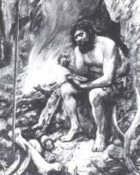
Neandertals
First found near Dusseldorf, Germany in 1856
Constructed to look ape-like
Brain capacity about 200 cc larger
Initial construction discovered to be wrong
Used jewelry
Used musical instruments
Did cave paintings
Capable of speech
Buried their dead

Slide 18
Neandertal Burial Cites
Marvin Lubenow, “Recovery of Neanderthal mtDNA: An Evaluation,” Creation Ex Nihilo Technical Journal, 1998 p.89.
“Most anthropologists recognize burial as a very human, and a very religious, act. But the strongest evidence that Neandertals were fully human and of our species is that at four sites Neandertals and modern humans were buried together.”

Slide 19
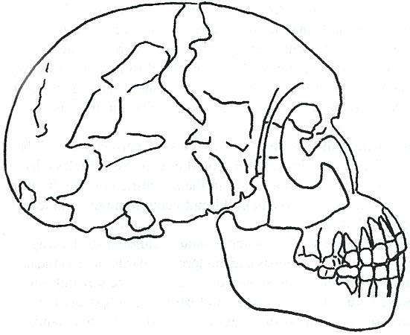
Rearranging the Data
From Buried Alive by Dr. Jack Cuozzo
Drawing of a Neandertal fossil purchased at the souvenir counter at the museum in Berlin giving an ape-like appearance
Lower jaw 30 mm (over an inch) out of the socket

Slide 20
Rearranging the Data
From Buried Alive by Dr. Jack Cuozzo
Flat, human appearance
Lower jaw 30 mm (over an inch) out of the socket

Slide 21
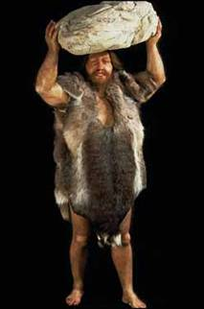
Neandertal Anatomy
Thick brow
Stocky body build
Short extremities

Slide 22
Neandertal Population
Common dates for Neandertals are 130,000 to 30,000 years ago
Neandertals existed for about 100,000 years (2,500 generations)

Slide 23
Neandertal Population
1
2000
300 million
6 billion
100 generations
Where are the fossils?
There should have been over 50 billion Neandertals that lived during this time!

Slide 24
Neanderthals
1964: Neanderthals are a sub-species of humans
1997: Neanderthals are a separate species (based on mtDNA find)
Luigi Cavalli-Sforza (Professor of genetics Stanford University), Genes, People, and Languages, 2000, p. 35.
“The results of mitochondrial DNA show clearly that Neandertal was not our direct ancestor, unlike earlier hypotheses made by some paleoanthropologists.”

Slide 25
Critical Thinking
How was this comparison made?
1,669 modern humans were compared with one Neanderthal

Slide 26
Statistics
Marvin Lubenow (Th.M., M.S. Anthropology), “Recovery of Neandertal mtDNA: AN Evaluation,” CEN Technical Journal, 1998.
“It is improper to use statistical 'averages' in situations where many entities are being compared with only one entity. In this case, 994 sequences from 1669 modern humans are compared with one sequence from one Neandertal. Thus, there is no Neandertal 'average,' and the comparison is not valid.”

Slide 27
Differences
When compared to modern humans there were 22 mtDNA substitution differences
Between modern humans the range is from 1 to 24 mtDNA differences
Neanderthal and human
22
Human and human
24
What does this mean?

Slide 28
Evolution and Logic
There are a few modern humans who differ by 2 substitutions more than the Neanderthal individual
Therefore, using evolutionists logic, these people are a separate species (not human)
~ 8% of the people here tonight are not human
Notes:
If you differ by more than 22 substitutions you fall outside the human range according to evolutionists
The single Neanderthal (mtDNA) was extracted from a small isolated group of Neanderthals
Possible explanations
Neanderthals did contribute to the modern gene pool, but their sequences disappeared through genetic loss or selection
The single Neanderthal (mtDNA) was fully human but at the extreme end
The single Neanderthal (mtDNA) was fully human but at the extreme end

Slide 29
Neandertal DNA
Nicholas Comninellis, M.D., Creative Defense: Evidence Against Evolution, 2001, p. 195. (citing Marvin Lubenow, “Recovery of Neanderthal mtDNA: An Evaluation,” Creation Ex Nihilo Technical Journal, 1998.)
“Analysis of Neanderthal DNA failed to demonstrate any significance from DNA of modern humans.”

Slide 30
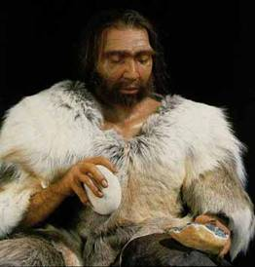
Conclusion About Neandertals
Protruding brow ridge
Stocky body build and short extremities
Isolated population of people
Lived in a cold, harsh climate
100% human
Neandertal man, reconstructed from a skull found in La Chapelle-aux-Saints, France

Slide 31
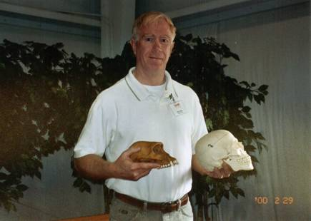
A Case Study in Deception
Lucy and the Australopithecines

Slide 32
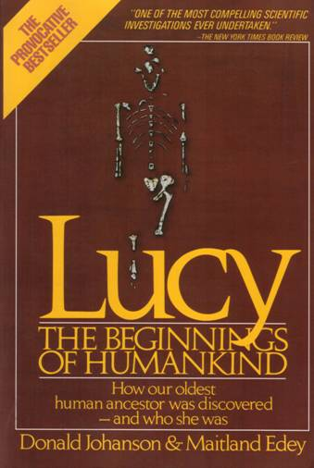
Lucy
What was found
Did Lucy walk upright
Note: Lucy is our ancestor

Slide 33
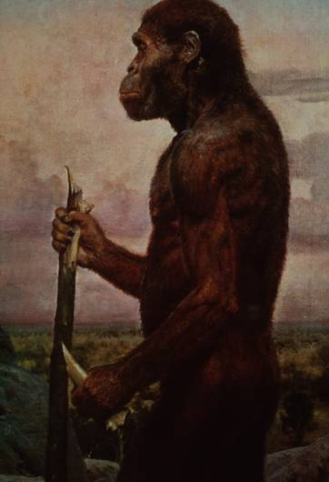
Challenges to Our Youth
Artistic conception
Australopithecus
africanus
What do you notice about this picture?
Note contemplative gaze, human hands and use of tools.

Slide 34
Evolutionary Preconception
John Gurche, artist, National Geographic, March, 1996 p. 109.
“I wanted to get a human soul into this ape-like face, to indicate something about where he was headed.”

Slide 35
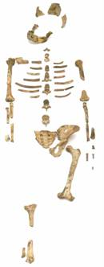
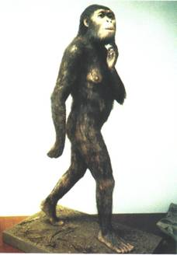
What Was Found?
Lucy discovered in 1974
About 40% of the fossil was found
Claimed to be 3.5 million years old
Claimed bipedal (walked upright)
Notes:
Picture of Lucy from: Biology: Understanding Life Third Edition, 2000

Slide 36
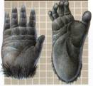
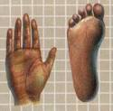
Lucy and the Australopithecines
No similarity in appearance to humans
Long arms are identical to chimpanzees
Jaws are similar to chimpanzees
Upper leg bone is similar to chimpanzees
Lucy's legs were very ape-like
Brain size (400-500 cc) overlaps chimpanzees
Large back muscles for tree dwelling
Hands similar to pygmy chimpanzee
Feet were long and curved

Slide 37
Did Lucy Walk Upright
To determine if Lucy walked upright three areas of anatomy were examined
The rib cage
The pelvis
Leg and foot bones

Slide 38
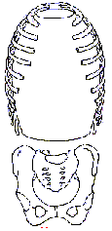
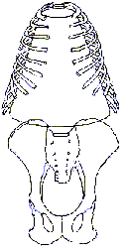
Rib Cage
Ape ribs are conical shaped
Human ribs are barrel-like
Human
Ape
Circular barrel-like
Conical shape

Slide 39
Lucy's Rib Cage
Peter Schmid (paleontologist at the Anthropological Institute in Zurich) Quoted from Origins reconsidered: In Search of What Makes Us Human by Richard Leakey and Roger Lewin
“I noticed that the ribs were more round in cross-section, more like what you see in apes. Human ribs are flatter in cross-section.
But the shape of the rib cage itself was the biggest surprise of all. The human rib cage is barrel shaped, and I just couldn't get Lucy's ribs to fit this kind of shape.”

Slide 40
Lucy's Rib Cage
Brad Harrub (Ph.D. Anatomy and Neurobiology) and Bert Thompson (Ph.D. Microbiology), The Truth About Human Origins, 2003, p. 47.
“In Lucy's case, her ribs are conical, like those found in apes.”

Slide 41
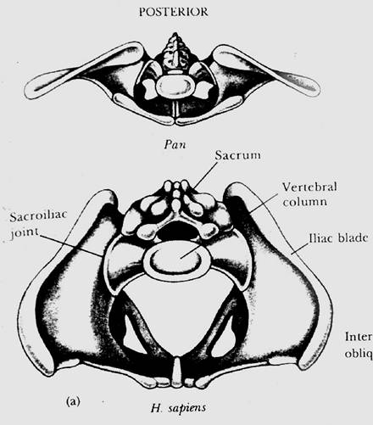
Chimp vs. Human Pelvis
Chimp
Human

Slide 42
Lucy's Pelvis
J. Stern & R. Sussman, American Journal of
Physical Anthropology, 1983, pp. 291 & 292.
“The fact that the anterior portion of the iliac blade faces laterally in humans but not in chimpanzees is obvious. The marked resemblance of AL 288-1 (Lucy) to the chimpanzee is equally obvious…
It suggests to us that the mechanism of lateral pelvic balance during bipedalism was closer to that in apes than in humans.”

Slide 43
Lucy's pelvis is “wrong” because it is very ape-like
PBS Nova Series; In Search of Human Origins
episode one 1994 (Dr. Owen Lovejoy)
Notes:
C. Owen Lovejoy is Chairman of Anthropology at Kent State University

Slide 44
“Fixing” Lucy with a power saw!
PBS Nova Series; In Search of Human Origins
episode one 1994 (Dr. Owen Lovejoy)

Slide 45
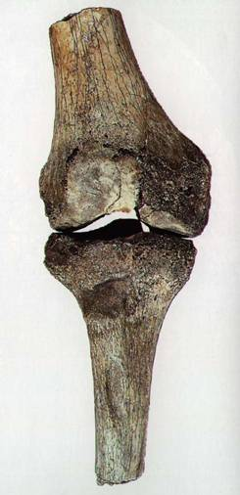
Knee Joint of A. afarensis
15° carrying angle (valgus)
Human = 9°
Gorilla = 0°
Chimp = 0°
Orangutan = 9°
Spider monkey = 9°

Slide 46
How Evolution Hinders Critical Thinking

Slide 47
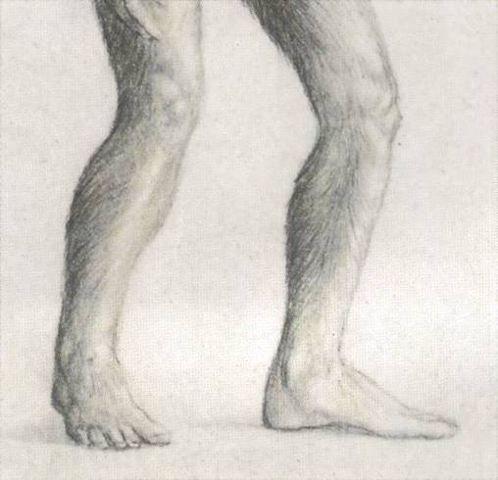
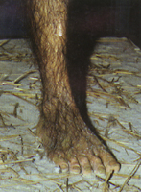
Lucy: What Nice Feet You Have
Drawing from Life: The Science of Biology, Purves, Orians, and Heller, 1992, p. 604.
St Louis zoo replica of Lucy

Slide 48
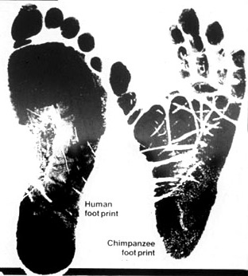
Apes and Humans – a Test
Human
Which footprint is human?
Notes:
This is not hard to distinguish

Slide 49
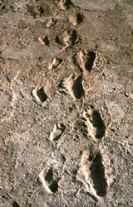
Laetoli Footprints
Footprints discovered in 1978 in Laetoli, Tanzania. The footprints were dated at 3.5 million years old.
Who made these footprints?

Slide 50
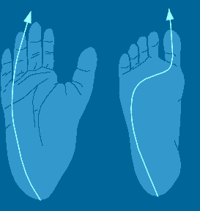
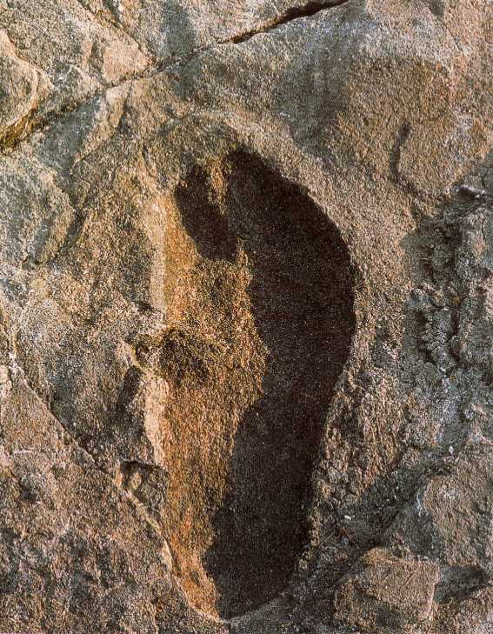
Ape and Human Footprints
Human
Ape
(Lucy)
Laetoli footprint

Slide 51
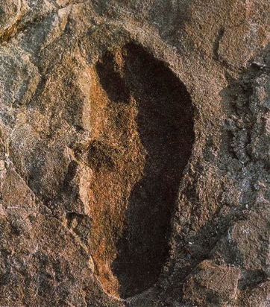
Footprints and Real Evidence
Russell Tuttle, “The Pattern of Little Feet,” American Journal of Physical Anthropology, Feb 1989, p. 316.
“Indistinguishable from those of habitually barefoot Homo sapiens.”

Slide 52
Anatomy of Australopithecines
David Catchpoole, Ph.D., “New evidence: Lucy was a knuckle-walker”, www.answersingenesis.org/docs2/4256news5-5-2000.asp
“…anatomist Dr Charles Oxnard has shown that the big toe actually sticks out as in chimpanzees.”

Slide 53
Lucy: Saint Louis Museum

Slide 54
Evolution Rejects the Evidence
“Professor Betsy Schumann, evolutionist expert, admits that the statue's feet 'probably are not accurate', but when asked whether the statue should be changed, she says,
'Absolutely not'.”
Creation ex nihilo, Dec 1996, p.52.
In other words, evolution must use bad science to deceive people

Slide 55
Textbooks Promoting Bad Science
Biology: Concepts and Connections, 2000, p. 404.
“Some 3.7 million years ago, several bipedal (upright-walking) human animals of the species Australopithecus afarensis left footprints in damp volcanic ash in what is now Tanzania in East Africa.”

Slide 56
Confusion about Lucy
Robert Boyd and Joan Silk, (both professors of anthropology), How Humans Evolved, 2000, pp. 331-334.
“Anatomical evidence indicates that A. afarensis was bipedal…”
…some anthropologists are convinced by the anatomical evidence that A. afarensis was not a modern biped.”
Why the confusion?
Why aren't students told about this?

Slide 57
Did Lucy Walk Upright?
1987 Charles Oxnard (Professor of Anatomy and Human Biology) Computer analysis
1992 American Journal of Physical Anthropology, Walked like chimpanzees
1993 Christine Tardieu, (Anthropologist) reported, “Its locking mechanism was not developed.”
1994 Journal of Human Evolution, A Biochemical Study of the Hip and Thigh

Slide 58
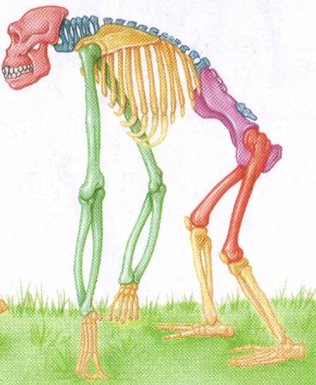
Did Lucy Walk Upright?
Richmand and Strait, “Evidence that Humans Evolved from Knuckle-Walking Ancestor,” Nature, 2000.
“Regardless of the status of Lucy's knee joint, new evidence has come forth that Lucy has the morphology of a knuckle-walker.”
E. Stokstad, “Hominid Ancestors May Have Knuckle Walked,” Science, 2000.
“I walked over to the cabinet, pulled out Lucy, and shazam! – she had the morphology that was classic for knuckle walkers.”

Slide 59
Did Lucy Walk Upright?
Charles Oxnard (professor of anatomy and leading expert on australopithecine fossils), The Order of Man: A Biomathematical Anatomy of the Primates, 1984, p. 332.
“The australopithecines known over the last several decades … are now irrevocably removed from a place in the evolution of human bipedalism,…
All this should make us wonder about the usual presentation of human evolution in introductory textbooks…”

Slide 60
Did Lucy Walk Upright?
Stuart Burgess (Ph.D. CEng), Hallmarks of Design, 2002, p. 166.
“There are so many unique features required for bipedal motion that it is impossible for a quadruped to gradually evolve into a biped.”

Slide 61
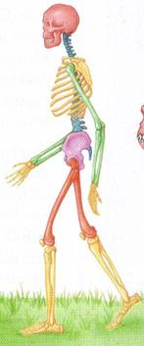
10 Unique Characteristics
Fine balance
Flat face
Upright skull
Straight back
Fully extendable hip joints
Angled femur bones
Fully extendable knee joints
Long legs
Arched feet
Strong big toes
Notes:
All these deal with being bipedal
FINE BALANCE: Requires a fine sense of balance. The inner ear has a network of fluid-filled canals which contain sensors which are sensitive to movement and gravity. The sensors consist of fine hairs which send out signals to indicate direction and speed. Humans have a more complex inner ear design than apes
FLAT FACE: So their eyes have a field of view which extends down to the ground in front of the feet.
UPRIGHT SKULL: the position at which the spinal cord enters the skull. In humans it is located at the bottom of the skull. This means the most natural position for the head is looking forward in the upright position.
STRAIGHT BACK: This is ideal for upright posture because the torso and head are directly above the hips in the standing position. Apes have a curved back.
FULLY EXTENDABLE FEMUR BONES: When looking from the front humans have femur bones which are angled inwards as they come down from the hip. This has the effect of making the knees and feet closer together. Having feet closer together keeps the feet nearly under the center of the body and gives stability during walking and running. During walking and running the body is supported by one leg at any instant and so the body can topple over if the legs are not right under the body. If the feet were not close together then the body would be thrown from side to side
FULLY EXTENDABLE KNEE JOINTS:
VERY LONG LEGS: The length of human legs is about half the total body. This makes it possible to walk and run for long distances with relative ease. In contrast, apes are only about a third.
ARCHED FEET: The human foot is arched between the ball of the foot and the toes. The foot has around 26 bones and many muscles and ligaments, tendons and nerves so the foot can flex between the heel and the ball. The arched structure of the foot makes it easy for a person to press down on the ball for the foot which is important for balance and control. This ability is also important for movements such as standing on tiptoe, running and turning. It also helps absorb shocks during walking and running. In contrast the feet and hands of apes are like hands suited for grasping.
STRONG BIG TOES: This feature is important for walking and running. For each step, the final push from the ground comes from the big toe. In order to propel the body forwards in a controlled manner, the big toe must be very strong. Apes have a toe designed for grasping. They cannot make a firm push from their big toe.

Slide 62
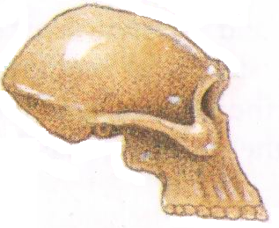
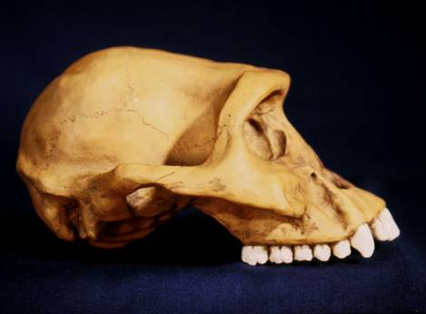
Textbooks and Accuracy
Eye socket
2
3
Flatter face
Teeth
1
Biology: The Web of Life, 1993

Slide 63
Mechanism for Change
Is it possible for a Lucy-like creature to evolve into a human?

Slide 64
Evolution and Change
A beneficial mutation occurs
Natural selection selects this mutation over any existing genes or other detrimental mutations that code for this function
The mutation is inherited by offspring
KEY: This process must add
New Information

Slide 65
Natural Selection
Ability to adapt to the environment
Survival of the fittest
Can natural selection cause one kind (species) to become a new kind?
No!
Natural selection ONLY works with existing information

Slide 66
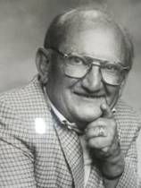
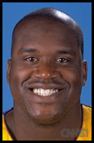
Human Variation
Watusi
Pygmy
Dwarfism
Basketball players
Eskimo (Inuit)
Billy Barty 3-foot-9
Shaquille O'neal 7-foot -1
This is an example of genetic variation and natural selection and NOT evolution

Slide 67
Mutation
Detrimental
Neutral
Beneficial
Disease
No change
Add information
No
Yes
No evolution
No evolution
Change morphology
yes
No
Evolution possible
No evolution

Slide 68
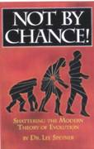
Mutations and Evolution
Lee Spetner (Ph.D. Physics – MIT, taught information and communications at Johns Hopkins University), Not By Chance, 1997, pp. 131, 138.
“But in all the reading I've done in the life-sciences literature, I've never found a mutation that added information…
All point mutations that have been studied on the molecular level turn out to reduce the genetic information and not increase it.”

Slide 69
Scientists
Linda K. Walkup, Ph.D. Genetics
Todd Wood, Ph.D. Genetics
Lane Lester, Ph.D. Genetics
James S. Allan, Ph.D. Genetics
Andre Eggen, Ph.D. Genetics
Maciej Giertych, Ph.D. Genetics
Leonard Korochkin, M.D., Genetics and Neurobiology
Kimberly Berrine, Ph.D., Microbiology & Immunology
Duane Gish, Ph.D. Biochemistry
Harriet Kim, Ph.D. Biochemistry
Bob Hoskin, Ph.D. Biochemistry
Neil Huber, Ph.D. Physical Anthropology
Kyoung-Tai Kim, Ph.D. Genetic Engineering

Slide 70
Summary
Evolutionists ignore the scientific evidence
Evolutionists create misleading pictures in textbooks to support evolution
Evolutionists practice censorship
The scientific evidence supports Lucy was an extinct type of chimpanzee
All the evidence supports “Created after their kind”, “Made in the image and likeness of God”

Slide 71
Psalm 139:14
I will praise thee; for I am fearfully and wonderfully made: marvellous are thy works; and that my soul knoweth right well.

Slide 72
AiG Web Address 00439
Over 1,000 Articles by Category

Slide 73
Black

Slide 74
Creation link at BibleStudyDownloads.org
Get this presentation for free!
Notes:
OT Survey (os)

